Slide 1
General Staff Meeting
DECEMBER 17, 2024
Simon fisher

Slide 2
MPI General Staff Meeting december 17, 2024
Agenda, Staff Meeting December 17, 2024
News from the MD
Departures and Arrivals
PhD defences
Upcoming events
Honours and awards
News from Data Protection Committee
News from TG, including RFC
News from Communications
News from Library Committee
News from Diversity, Equity & Inclusion Committee
News from Research Staff Committee
News from Equal Opportunities
News from Sustainability Working Group
***
End of the Year party

Slide 3
MPI General Staff Meeting december 17, 2024
Departures and arrivals
Research Staff (RS), PhD students, other staff and long-term guests leaving
Han Sloetjes 31.12.24
Cas Coopmans 31.12.24
Lucía de Hoyos Gonzalez 31.12.24
Rong Ding 31.12.24
Anita Slonimska 14.01.25
Orhun Uluşahin 14.01.25
Benedicte Mbala-Nguyen 31.01.25
Gabriela Garrido 31.01.25
Johan Ros 31.01.25
Deema Takaleh 28.02.25
Ciske Jansen 28.02.25
Eric Fleischer 28.02.25
Martina Mellana 14.03.25
New Research Staff (RS), PhD students and other staff (present) Department/Group
Selim Sametoglu RS 01.10.24 Language Development
Helin Erden RA 01.10.24 Psychology of Language
Jule Hafermann PhD 15.10.24 Language Development
Nicole Ng PhD 01.11.24 Language and Genetics
Teun van Gils 01.12.24 Technical Group

Slide 4
MPI General staff meeting december 17, 2024
Departures and arrivals
New Research Staff (RS) and PhD students (expected) Department/Group
Bahar Tarakci Denizli PhD 01.01.25 Multimodal Language
Carmen Ramoser PhD 15.01.25 Language and Genetics
Erik van Stuivenberg Head HR 01.02.25 Operations
Gökberk Alagöz RA 01.02.25 Language and Genetics
Lucía de Hoyos Gonzalez RA 01.02.25 Language and Genetics
New Guests (present) Host
Divyanshu Pathak 01.11.24 Talent+ (LEADS)
Montserrat Soberanes Morales 01.11.24 Talent+ (MLD)
Diane Gusmao da Silva 01.10.24 Language and Computation in Neural Systems
New Guests (expected) Host
Cecilia Rojas Nieto 06.01.25 Caroline Rowland
Inbal Arnon 10.03.25 Caroline Rowland

Slide 5
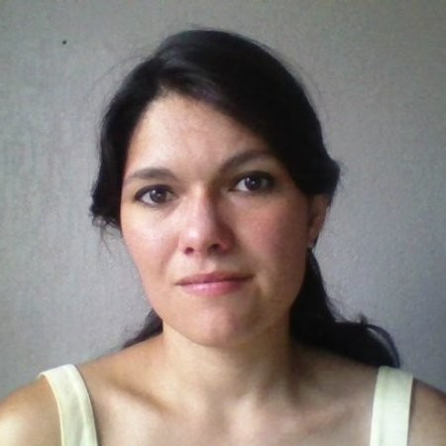
MPI General staff meeting december 17, 2024
PhD defences since last Staff Meeting
Ine Alvarez van Tussenbroek on December 4, Leiden University
Neotropical bat species: An exploration of brain morphology and genetics

Slide 6
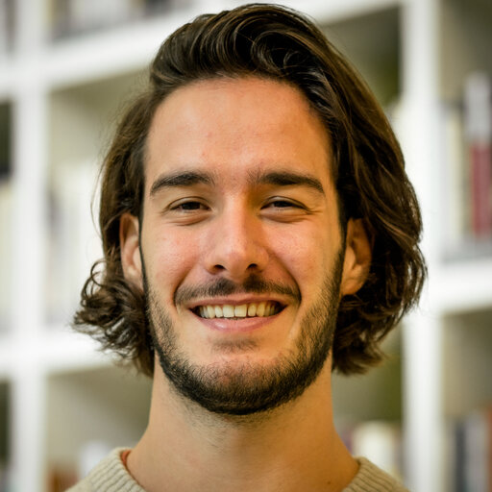
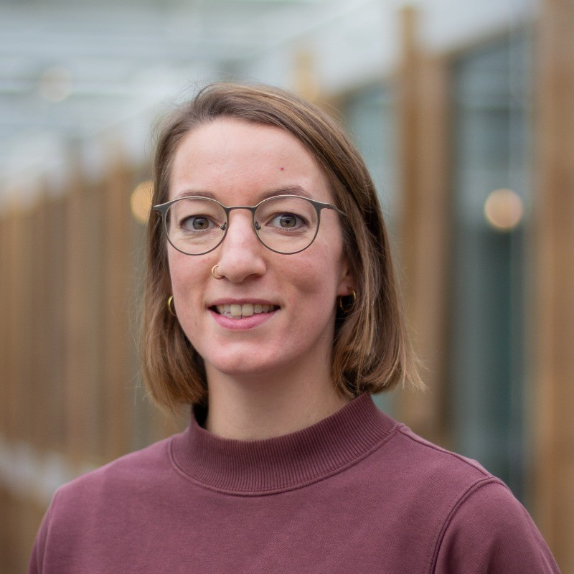
MPI General staff meeting december 17, 2024
Upcoming PhD defences
Giulio Severijnen on February 14, 2025
A blessing in disguise: How prosodic variability challenges but also aids successful speech perception
Natasha Roos on February 28, 2025
Naming a Picture in Context: Paving the way to investigate language recovery after stroke

Slide 7
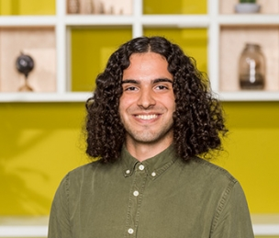
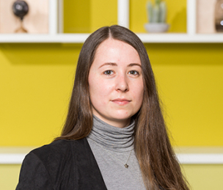
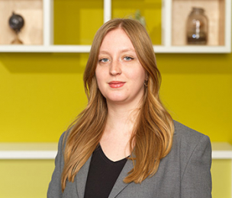
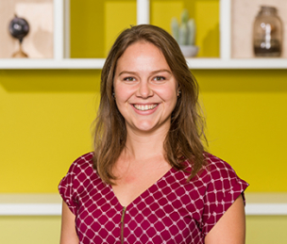
MPI General Staff meeting december 17, 2024
PhD representatives – who are we?
Orhun Uluşahin PoL Clara Kunst LaDD Loïs Dona MLD
Daniëlle Admiraal L&G
External PhD rep
phd-reps@mpi.nl
Notes:
There is a new external PhD rep!

Slide 8
MPI General Staff Meeting december 17, 2024
Upcoming Events 2025-2026 – Save the dates
Nijmegen Lectures by Vic and Fernanda Ferreira
Jan 07-09
MPI General Staff Meetings in 2025
March 18, June 17, September 9, December 16
Newcomers meetings 2025
13 February, 15 May, 18 September, 13 November
Kuratorium
March 24
10th conference on ISGS
July 9-11
Fachbeirat 2026
January 26-30, 2026

Slide 9
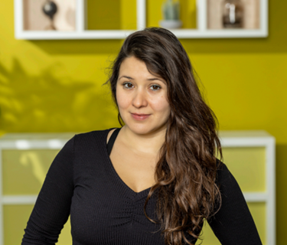
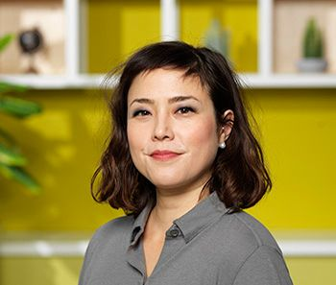
MPI General Staff meeting december 17, 2024
Honours and awards – Congratulations
Nwo vidi Grant for limor raviv
'From Grunts to Grammars: Unpacking language evolution with humans and robots in virtual environment'
ERC Consolidator Grant for Andrea E. Martin
DYNALANG: ‘Integrating structure and statistics in language processing: an ecological neural dynamics and manifolds approach’.

Slide 10
Data Protection
Updates staff meeting 17 December 2024
Oxana Grosseck

Slide 11
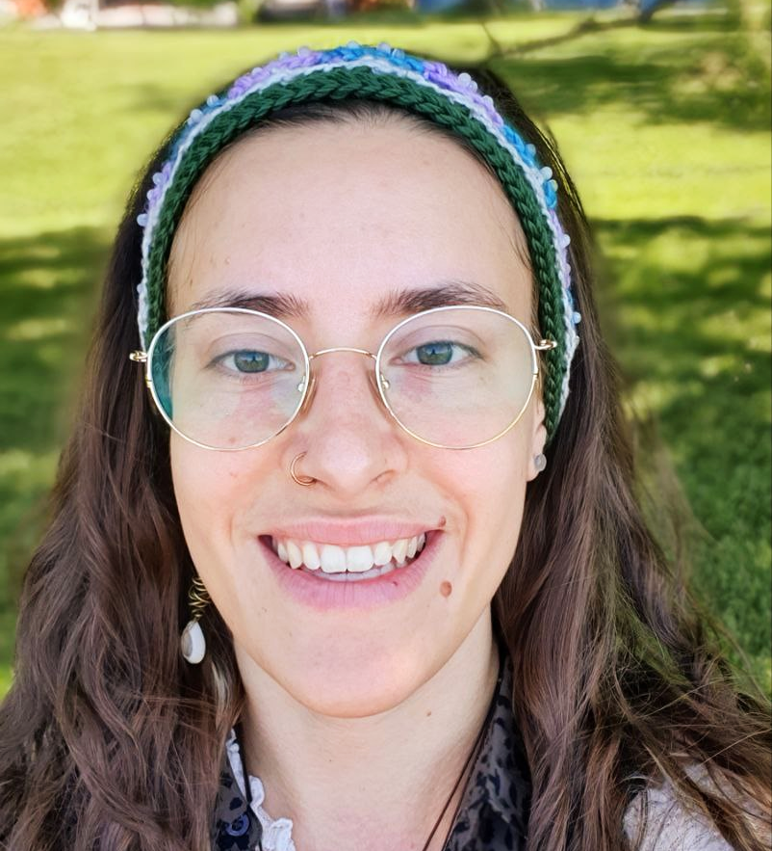
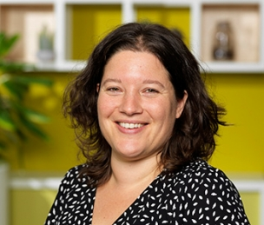
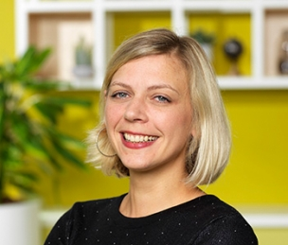
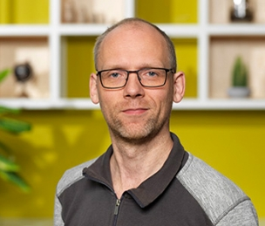
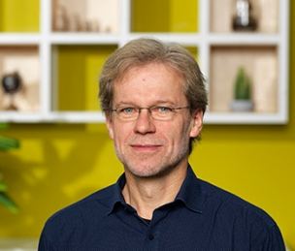
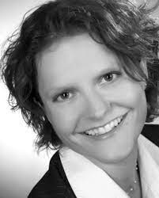
DATA PROTECTION
Team behind privacy@mpi.nl
Annelies van Wijngaarden
DPCo Deputy
Patricia Manko
Consultant
Oxana Grosseck
New DPCo
Heidi Schuster
Central Data Protection Officer (Munich Headquarters) datenschutz@mpg.de
Tobias van Valkenhoef
IT Security Officer
Reiner Dirksmeyer Head of TG
Notes:
Most of you have met Heidi now
Patricia – helps us, but not acting DPCo – not the one emails should go to

Slide 12
DATA PROTECTION
Updates
Please use privacy@mpi.nl email for data protection matters
We work through the ticketing system
October workshops wrap-up
GWDG AI tools
Notes:
Basically a reminder that it’s not Patricia anymore
Privacy: Seen by Oxana, Annelies, Pati, plus the relevant people from TG (Reiner, Tobias, Alex, Maurice etc)
Mention that for sensitive things they can still get in touch with me personally

Slide 13
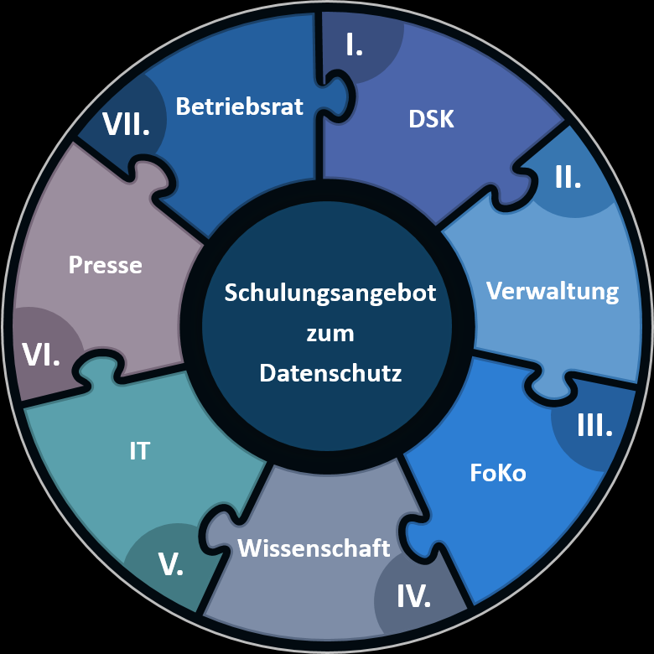
DATA PROTECTION
Updates
Thank you for taking part in the data protection workshops!
Course materials were sent out for those who couldn’t make it
If anyone else would like the materials, get in touch!
Notes:
Appreciate that so many people came
Hope it was informative

Slide 14
DATA PROTECTION
Updates
GWDG-hosted AI tools
Free
Secure: locally hosted & doesn’t save data
LLM Chatbots
Several high-quality, open-source LLMs
GPT-4 (not locally hosted)
Via web interface or API
Code Completion for VSCode (Codestral)
Protein AI
Voice-AI transcription & captioning (Whisper)
Training datasets for ML applications
Notes:
Many people are using AI in some capacity in their work
Not safe to input personal or confidential data
Alternative: GWDG (our partner for IT solutions incl email etc)

Slide 15
DATA PROTECTION
Reminder: Software
Overview
https://maxintra.mpi.nl/TG/software
New Software?
http://lux102.mpi.nl/forms/software-request-form
We need agreements with software providers, whenever they process personal or sensitive data on our behalf
Companies / software providers located outside the EU: NEVER input personal or sensitive data → data breach!
Notes:
Includes google

Slide 16
DATA PROTECTION
Reminders
Data breach?
Contact: data-breach@mpg.de & privacy@mpi.nl
Data Protection training
Mandatory for all employees, also for interns, lab rotation students, guests
Haven’t received training yet? Contact us!

Slide 17
TG / RFC
STAFF meeting December 17, 2024
Reiner Dirksmeyer

Slide 18
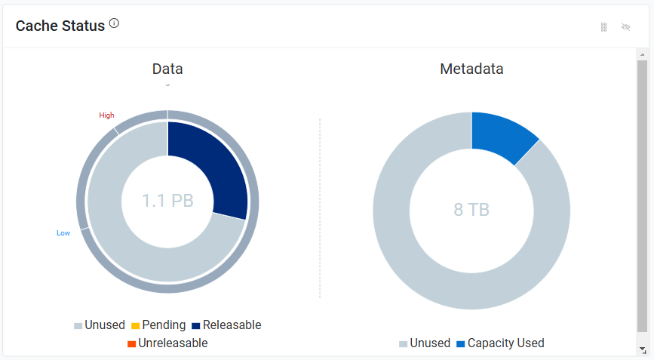
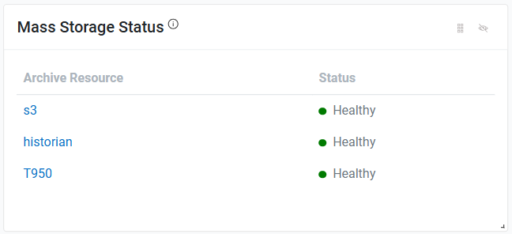
TG
Short report:
New general Storage: - Migration to our new storage hardware/software successfully done on 12/13-Oct-2024 → the new HSM (Hierarchical Storage Management) software works reliably!
New HPC-cluster Storage (clusterfs): - Migration to new storage hardware done - Upgrade to new BeeGFS version done → Much more reliable!

Slide 19
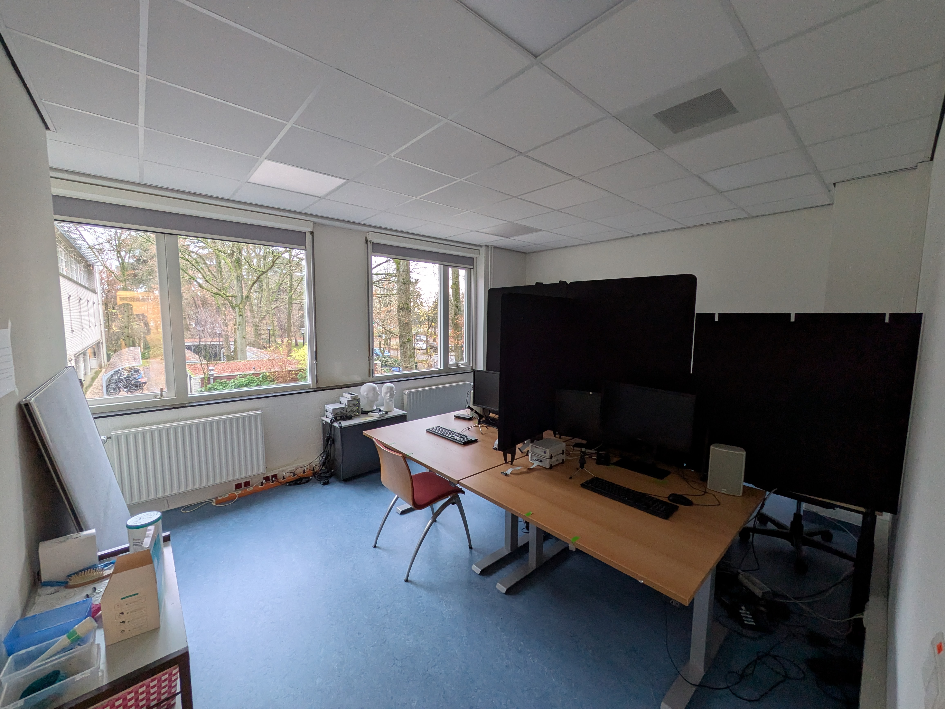
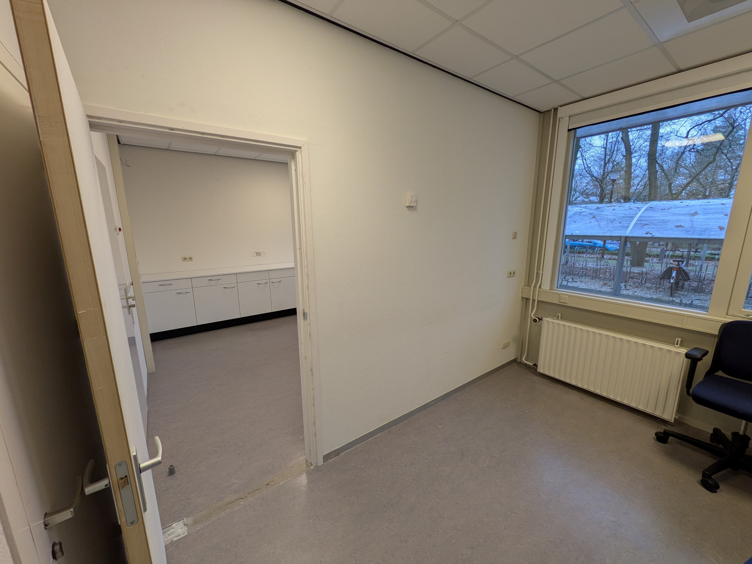
TG
Short report:
Others: - Windows 10 to Windows 11 migration: to-do: ~40 Desktop PC + 25 Laptops + 10 Experiment Laptops (187 PC already on Windows 11)
- Certificates (for e-mail signing): Service provider Sectigo has terminated contract to 10-Jan-25
- Double EEG/eye-tracker-Lab: reconstruction started
Room 222
Room 133/132b

Slide 20
TG
Short report:
Others: - M365 and Microsoft licensing
- User-based licening for all Microsoft products in the near feature! → Alternative: openDesk (Openoffice, Libreoffice), Linux

Slide 21
TG
Short report:
Others: - VMware: new owner (Broadcom), new prices (factor 2-3)! → Alternative: Proxmox (open source, based on KVM)
- Anaconda: new license and costs! → Alternative: Miniconda, Conda (fork of anaconda)
- Archiving old data to long-term archive to GWDG! → Started moving data from former departments (that have not been archived to our archive system) to GWDG long-archive (files here will be deleted)
- RFC meeting on 10-Dec-24: → It was decided to set up a new working group to support the timely development of a new
participant data base Annelies van Wijngaarden will take the initiative to set up this working group. → First budget plan for 2025 was introduced by Reiner, which will now be discussed in the directorate. → If you have any new request for equipment for experiments, compute resources or others, please let me or RFC know! → PhD representative: PhDs sometime buy notebooks from their own funds. Enough notebooks will be available in the future to cover their needs (e.g. working on a notebook while supervising a
participant in an experiment).

Slide 22
Research Facilities Committee
STAFF meeting December 17, 2024
WHO will present

Slide 23
Communications
STAFF MEETING DECEMBER 17, 2024
ANNIEK CORPORAAL

Slide 24
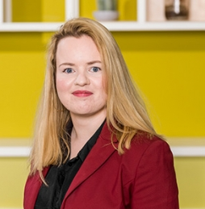
ANNIEK CORPORAAL | communications team | 17 DECEMBER 2024
ANNIEK CORPORAAL | communications team | 17 SEPTEMBER 2024
Team Communications
Feel free to drop in: Rooms 260 & 261
Mail us at communications@mpi.nl
Anniek Corporaal
Julia von der Fuhr
Ludy Cilissen
Yne Persyn

Slide 25
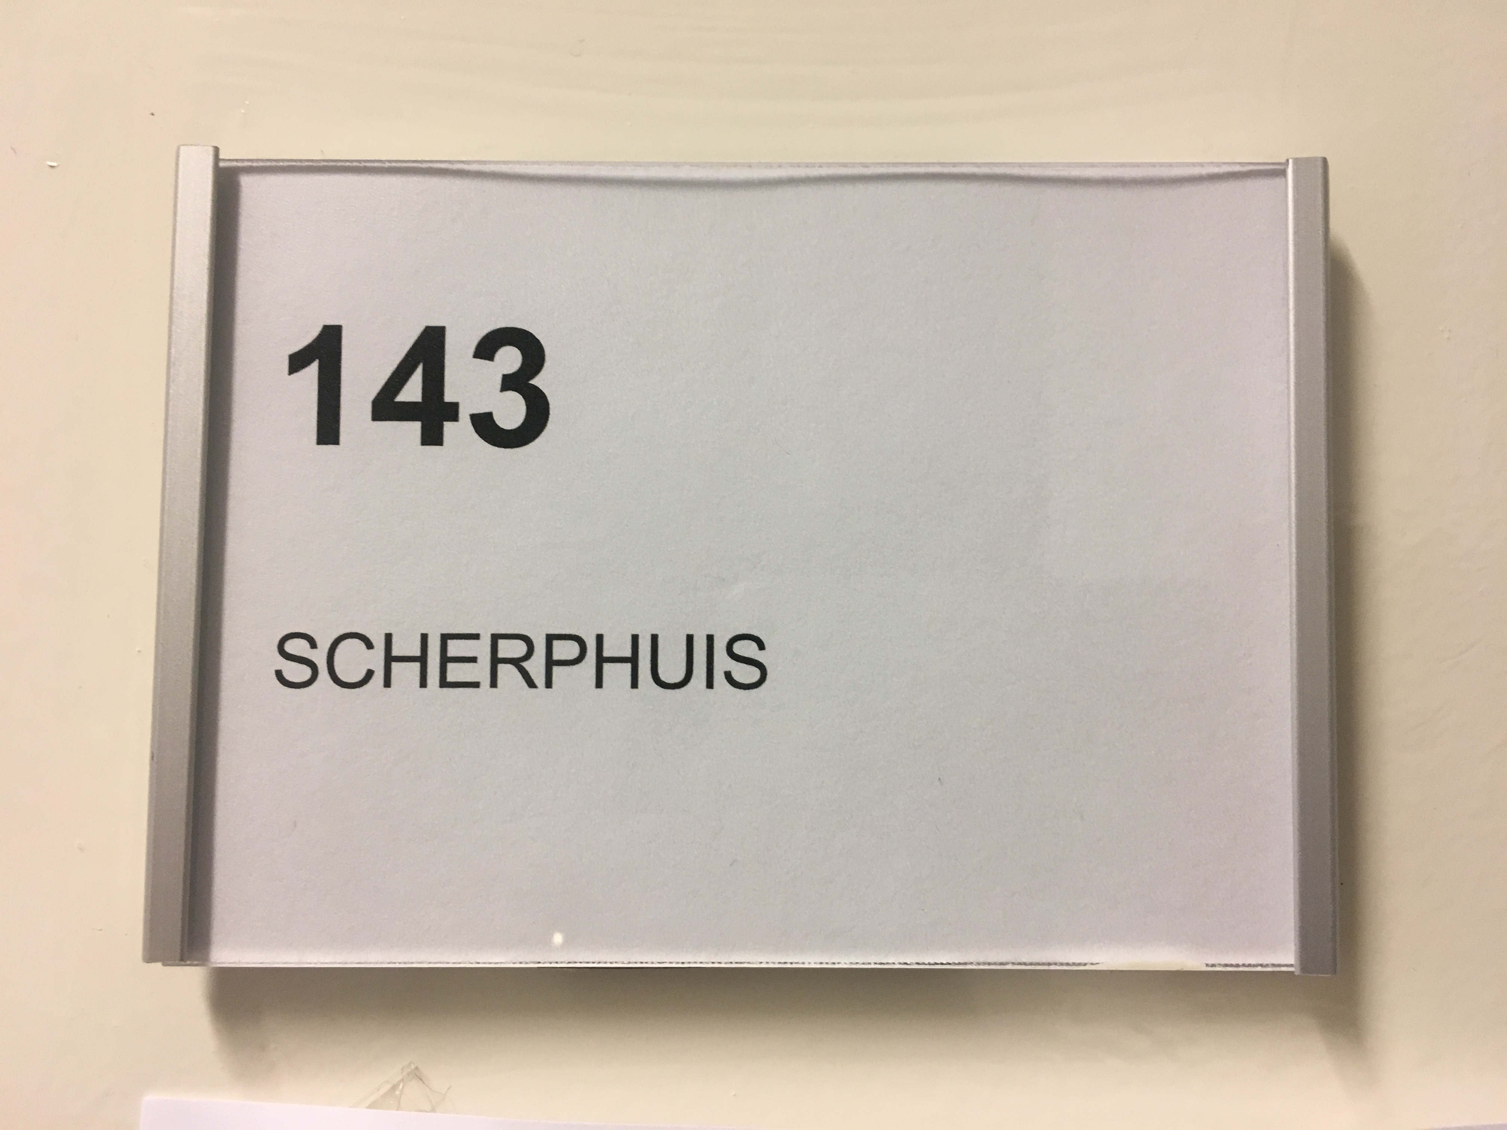
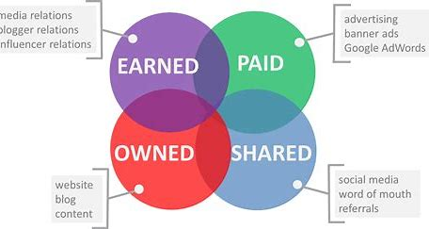
ANNIEK CORPORAAL | communications team | 17 DECEMBER 2024
Team Communications is here to
establish and secure the authority of Max Planck Institute for Psycholinguistics in the scientific world,
increase our visibility & findability as research partner and employer on a global scale and
support our research(ers) with participant recruitment,
pushing forward a vision where everyone is seen, heard and valued

Slide 26
ANNIEK CORPORAAL | communications team | 17 DECEMBER 2024
Building a strong brand:
Corporate Identity is fundamental
Updated brand guide & templates expected in February 2025

Slide 27
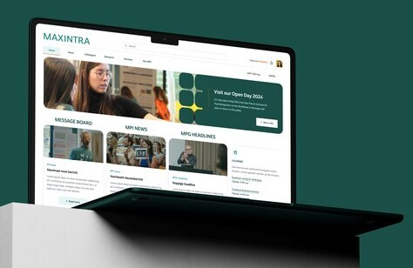
ANNIEK CORPORAAL | communications team | 17 DECEMBER 2024
The new Maxintra is launched
Please amend your personal profile Need help? Check Tutorials | MaxIntra or email communications@mpi.nl

Slide 28
ANNIEK CORPORAAL | communications team | 17 DECEMBER 2024
Weekly on Tuesdays: Inside our Institute
Share your contributions via communications@mpi.nl

Slide 29
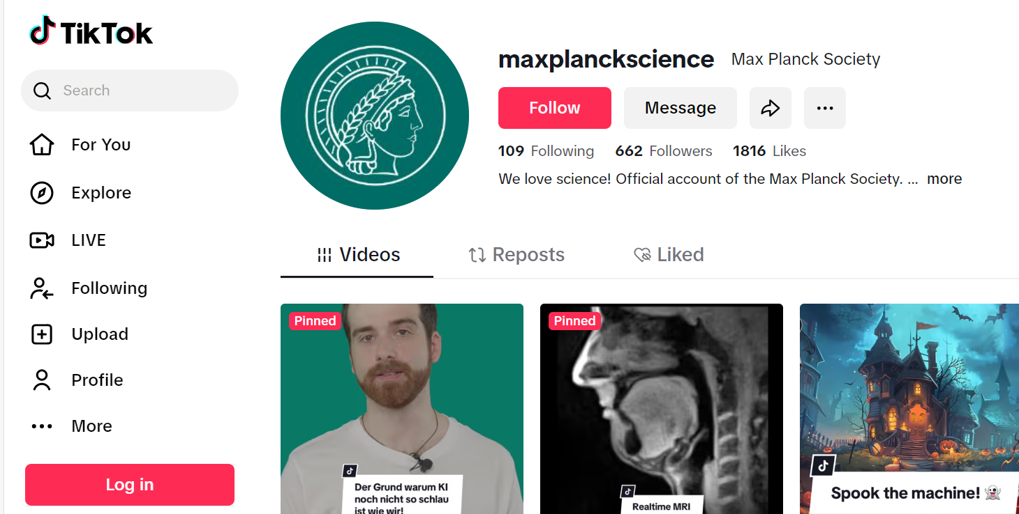
ANNIEK CORPORAAL | communications team | 17 DECEMBER 2024
Social media: follow us on Bluesky (& spread the word)
@MPI_NL
@mpi_nl
Max Planck Institute for Psycholinguistics
Max Planck Institute for Psycholinguistics
@MaxPlanckInstituteforPsycholinguistics
Notes:
This brings our number of social media accounts currently to 6. We use the channels to communicate with our various audiences in a targeted way.

Slide 30
ANNIEK CORPORAAL | communications team | 17 DECEMBER 2024
Into blogging? Join our blogger’s team!
Send an email to communications@mpi.nl

Slide 31
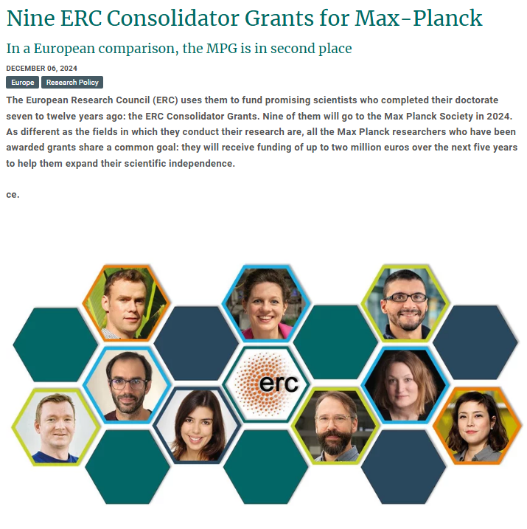
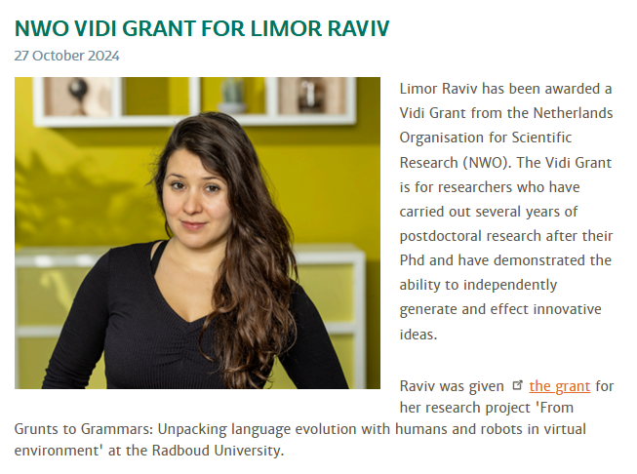
ANNIEK CORPORAAL | communications team | 17 DECEMBER 2024
Media Outreach: Grants

Slide 32
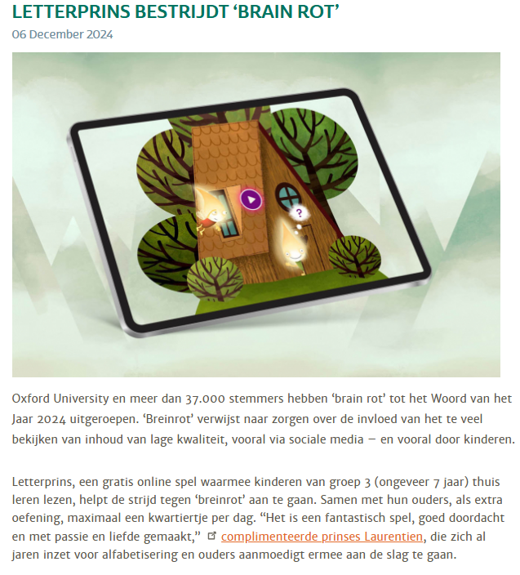
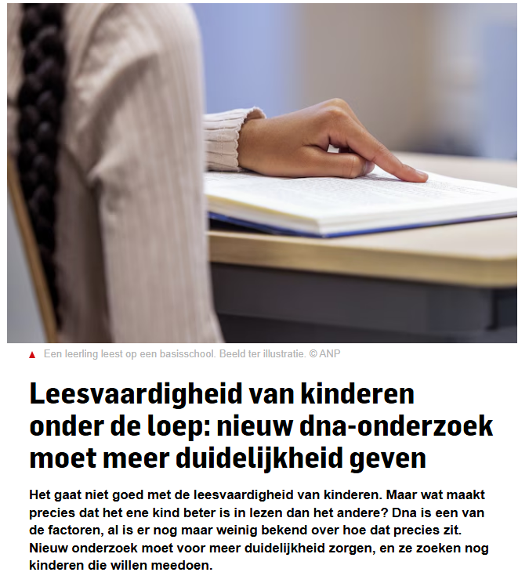
ANNIEK CORPORAAL | communications team | 17 DECEMBER 2024
Media Outreach: Letterprins

Slide 33
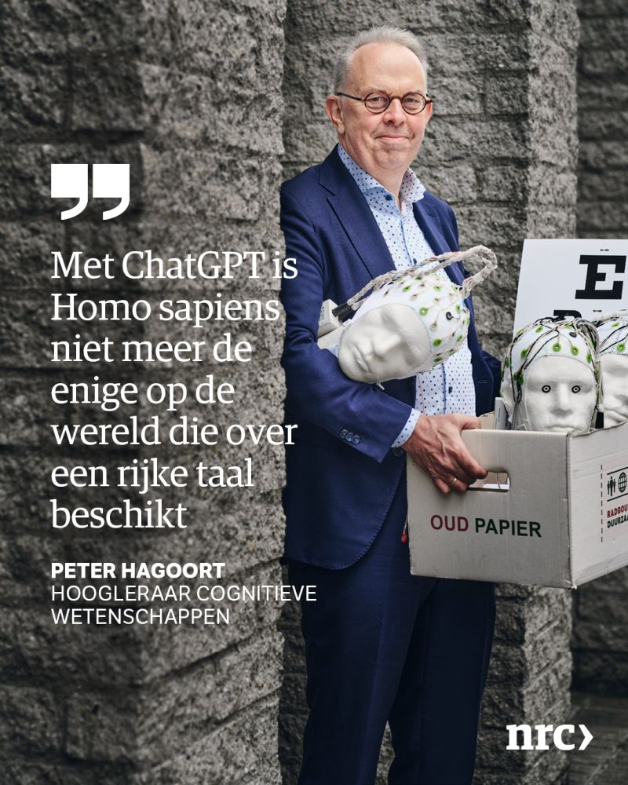
ANNIEK CORPORAAL | communications team | 17 DECEMBER 2024
Peter Hagoort

Slide 34
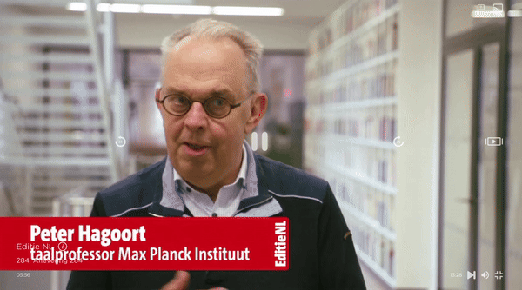
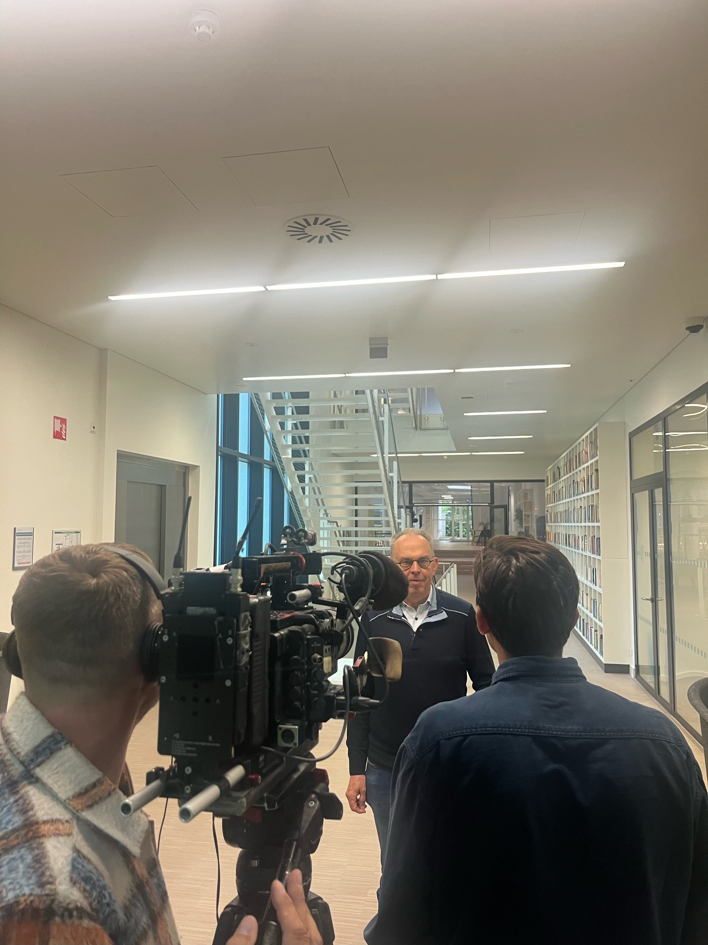
ANNIEK CORPORAAL | communications team | 17 DECEMBER 2024
Peter Hagoort
EditieNL
10 oktober 2024

Slide 35
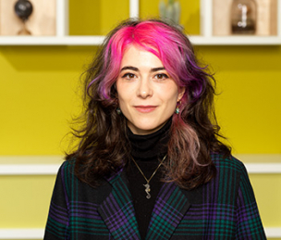
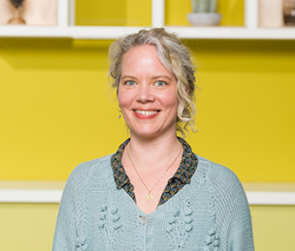
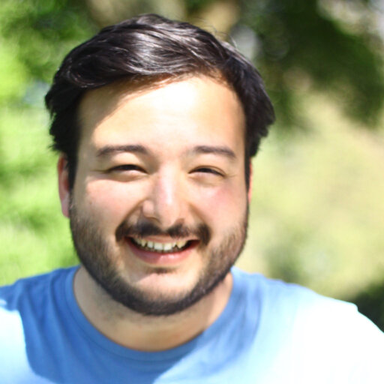
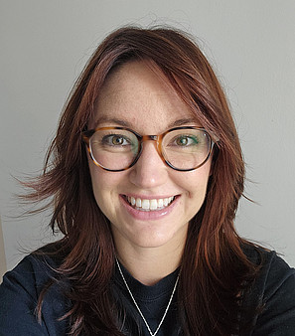
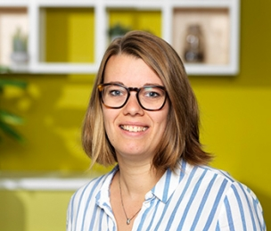
ANNIEK CORPORAAL | communications team | 17 DECEMBER 2024
MPI x InScience Film Festival
11-16 March 2025 | Save the Date: 14 March 2025 13:00-16:00 @ our Institute

Slide 36
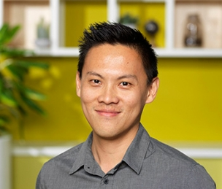
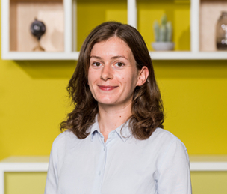
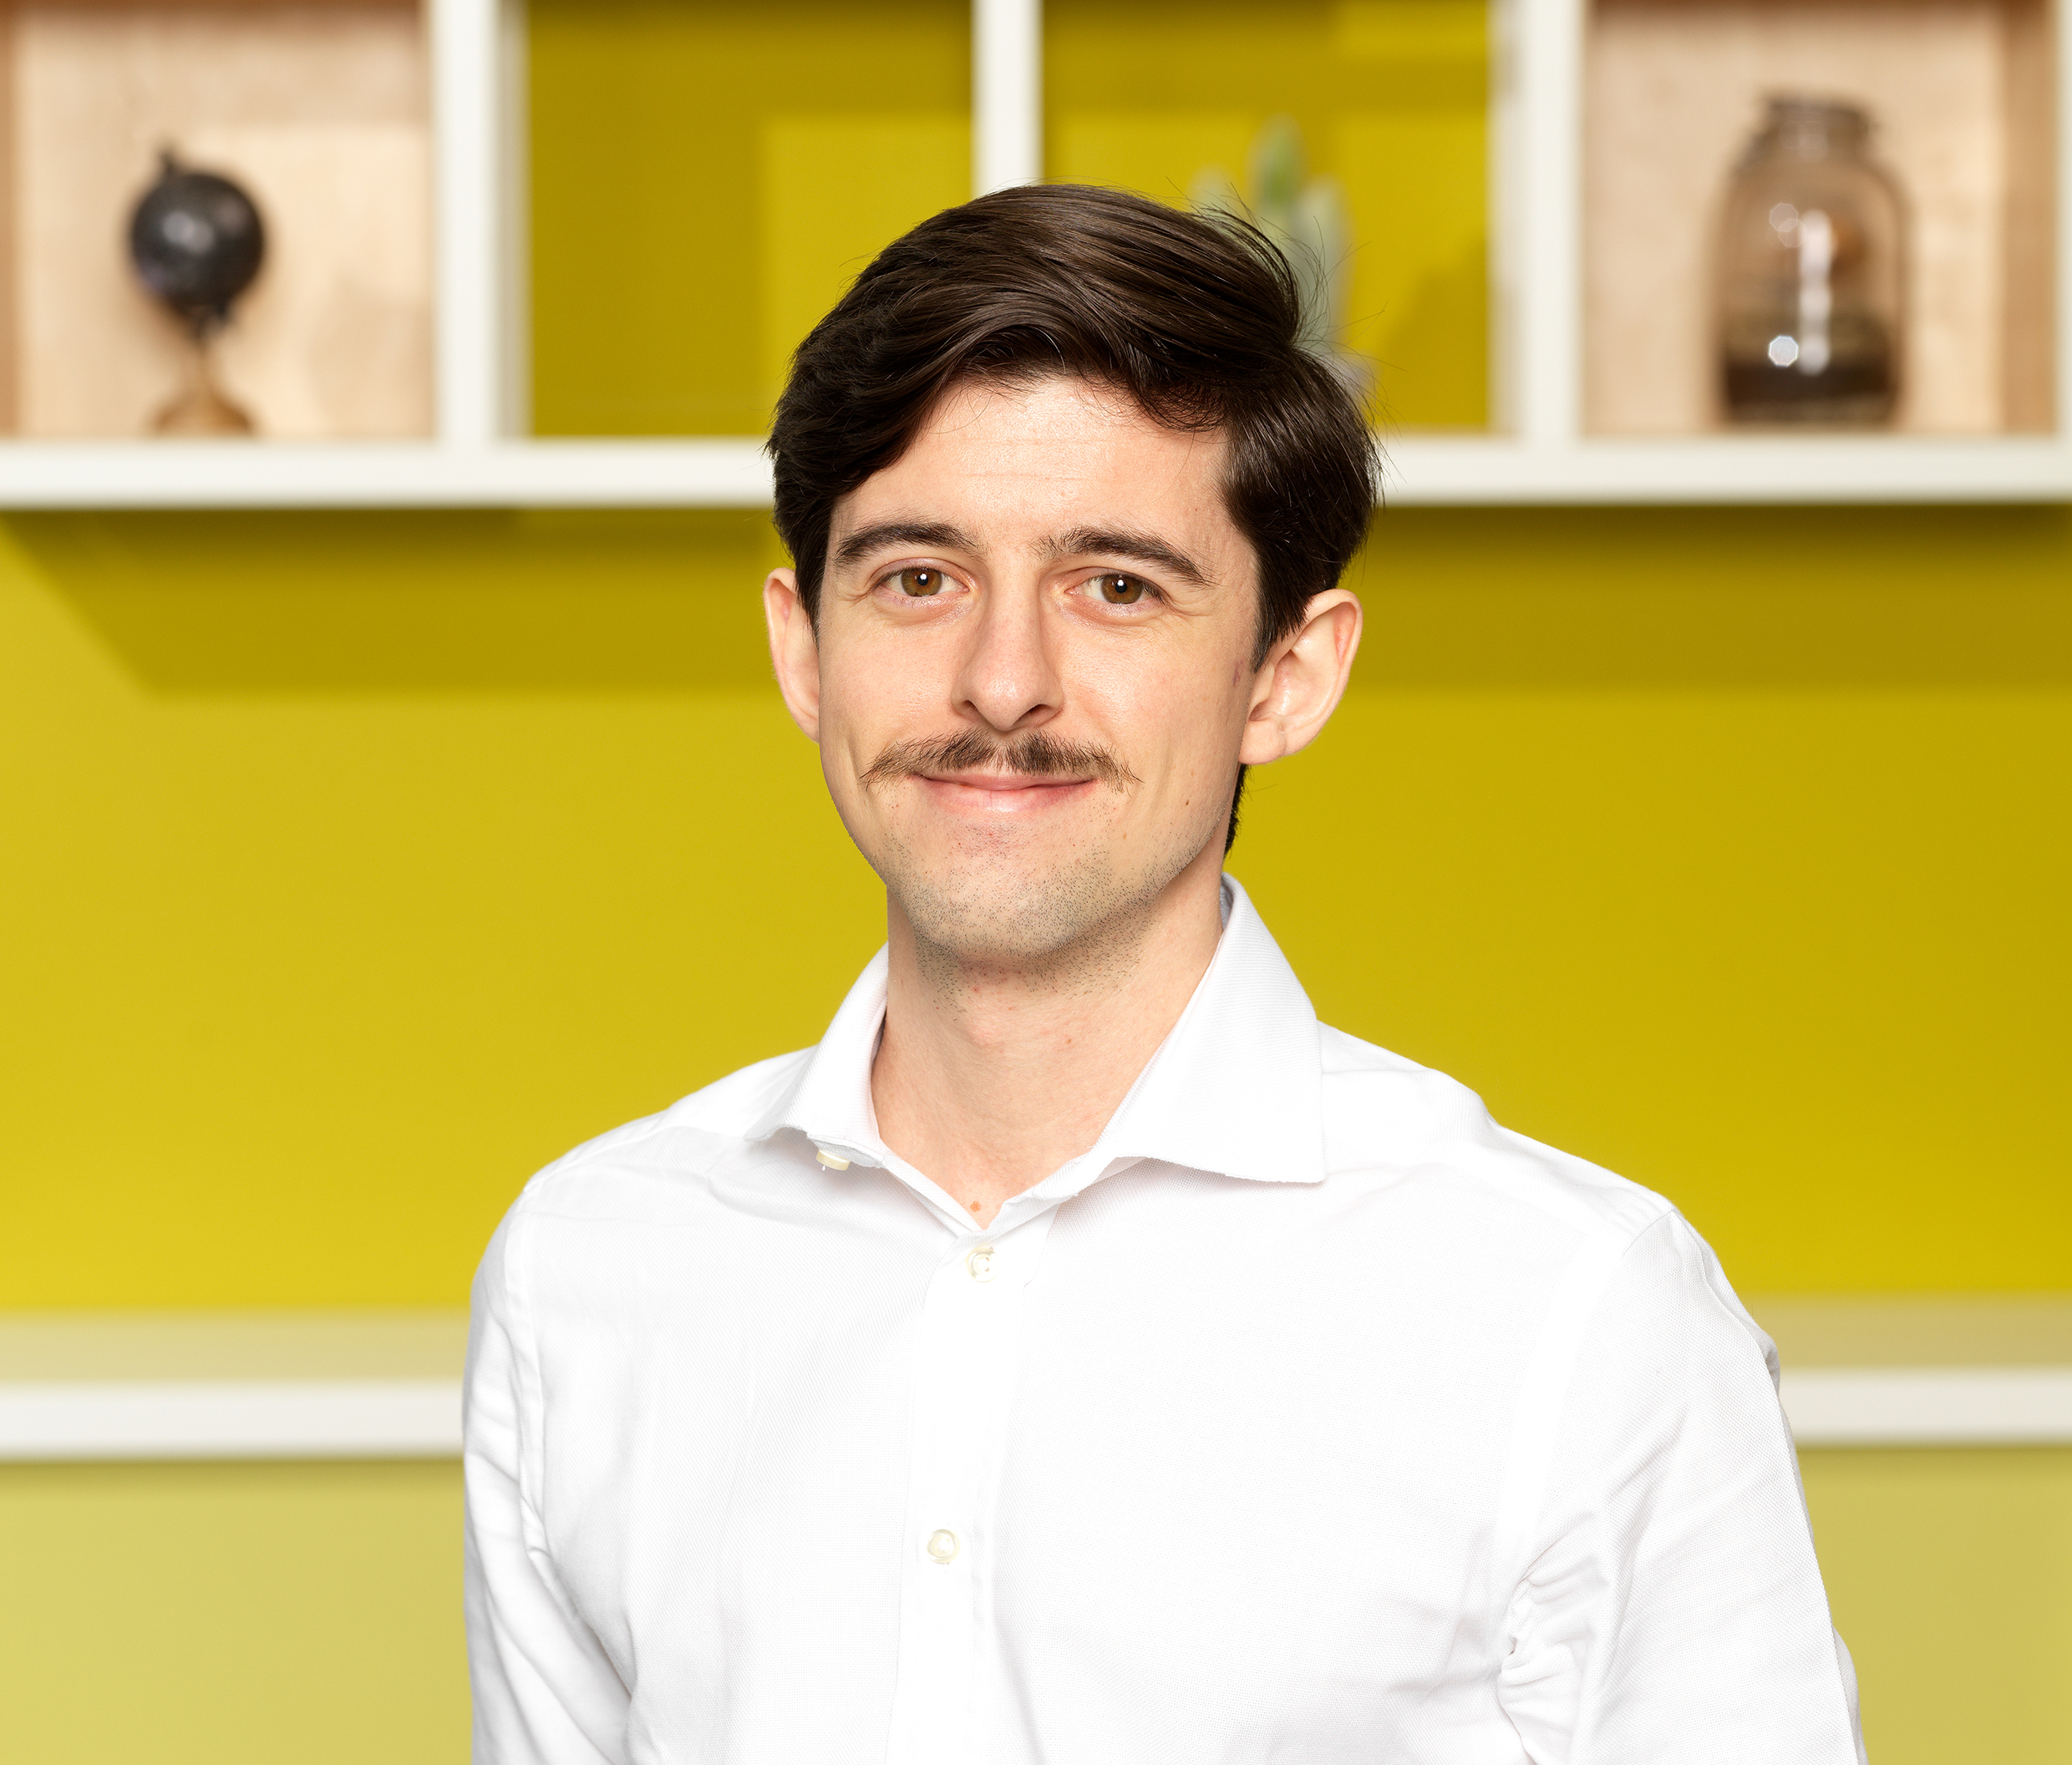
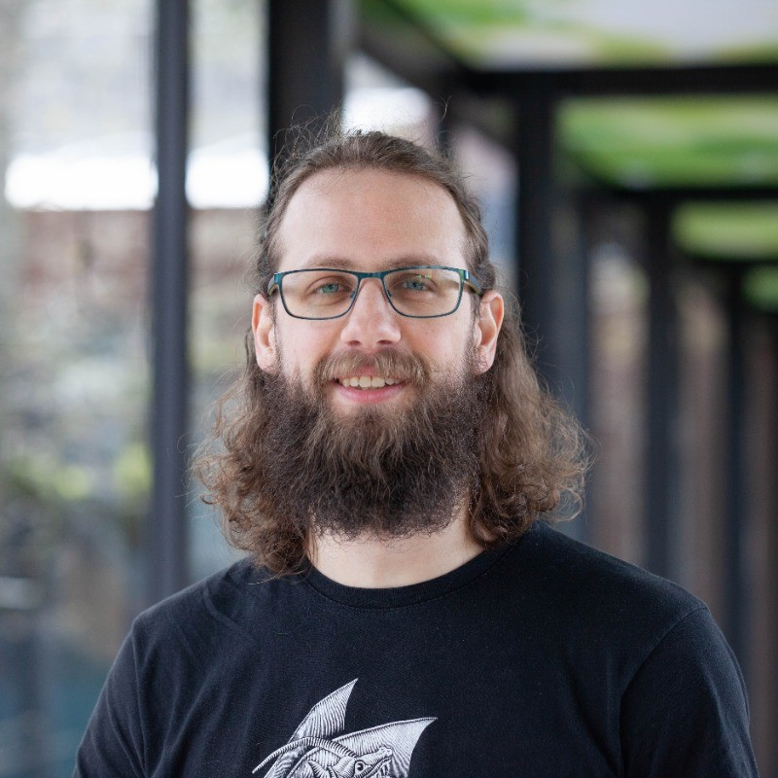
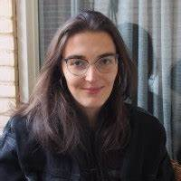
ANNIEK CORPORAAL | communications team | 17 DECEMBER 2024
Bite-Sized Insights:
4 February 2025 12:00-13:00
Common Ground
Three snackable presentations by PhD Candidates
Mark your calendars and join us!
Notes:
I’d imagine you’d like to know what we communicate to the outside world regarding your research - so you know what information our audiences receive.
Feel free to sign up to our quarterly external newsletter, the link is here in the slide.

Slide 37
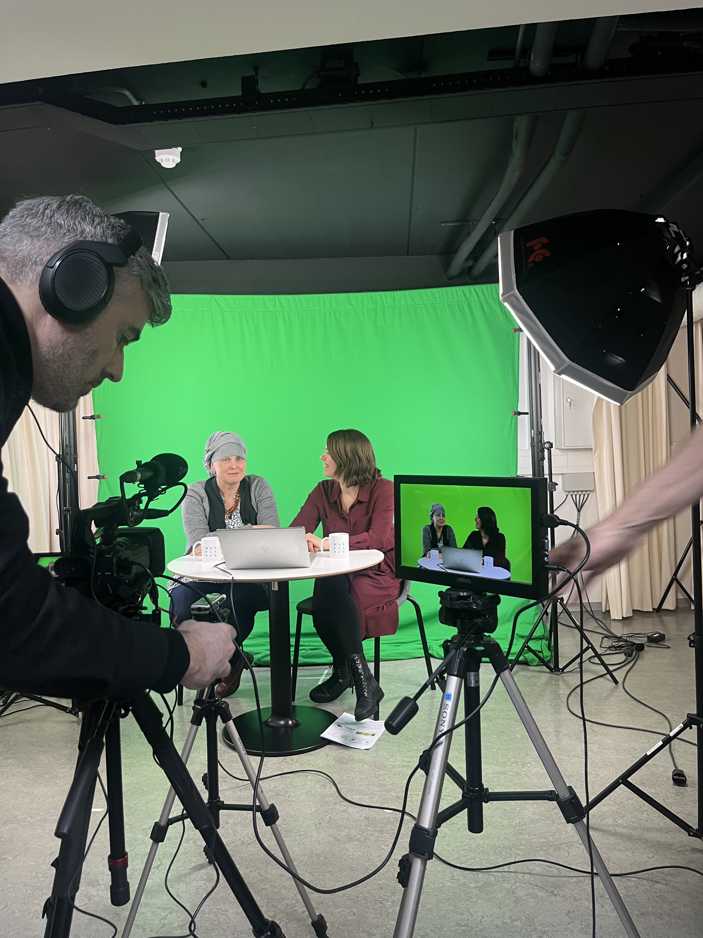
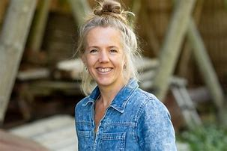
ANNIEK CORPORAAL | communications team | 17 DECEMBER 2024
& more!
Research Report 2023/2024 Call for content
Photography Next shoot planned in February (invitation only)
Video production Now running: pilot for tutorials, lectures and prerecorded webinars running, video of Motion Capture Lab planned, new corporate video planned for Q3 2025
Notes:
I’d imagine you’d like to know what we communicate to the outside world regarding your research - so you know what information our audiences receive.
Feel free to sign up to our quarterly external newsletter, the link is here in the slide.

Slide 38
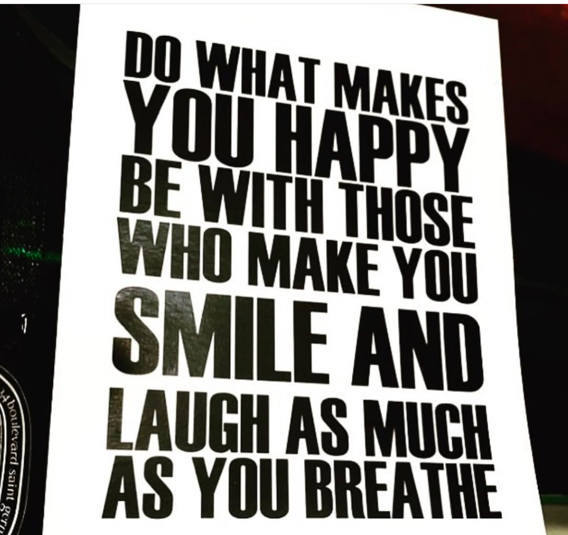
ANNIEK CORPORAAL | communications team | 17 DECEMBER 2024
ANNIEK CORPORAAL | communications team | 17 SEPTEMBER 2024
Happy Hols!

Slide 39
Colloquium committee
Staff meeting December 17, 2024
Sergio miguel perreira-Soares

Slide 40
Library Committee Report incl. Open Science Ambassadors
Staff meeting December 17, 2024
Karin kastens

Slide 41
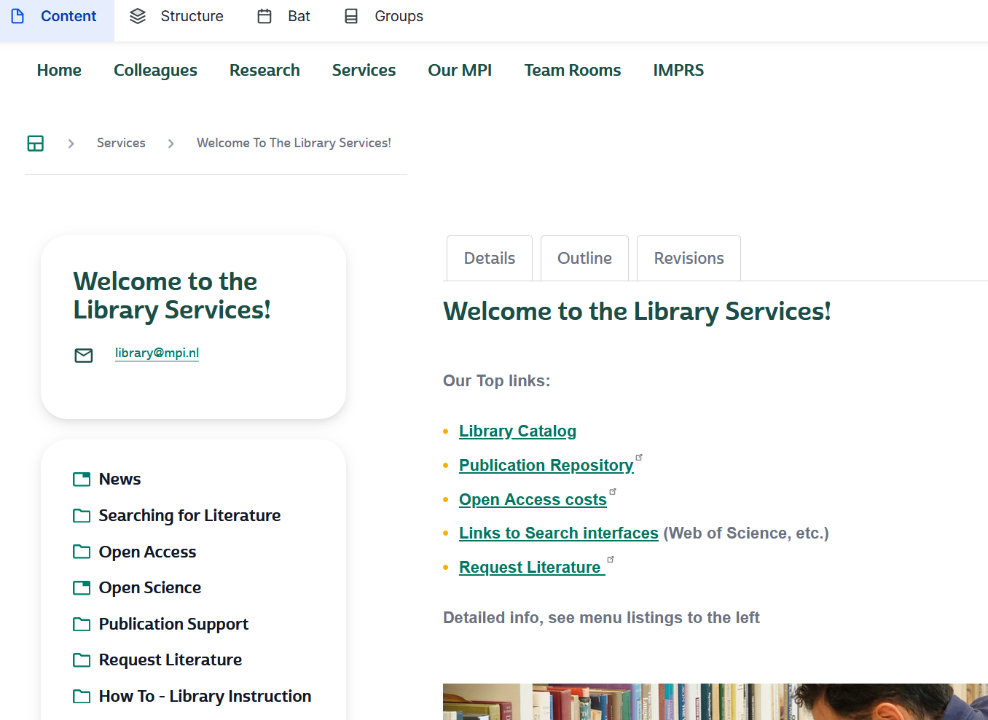
Mpi general staff meeting december 17, 2024
Reminder Open Access Agreements
Check if MPG has an agreement
https://oapublishing.mpdl.mpg.de/journals/

Slide 42
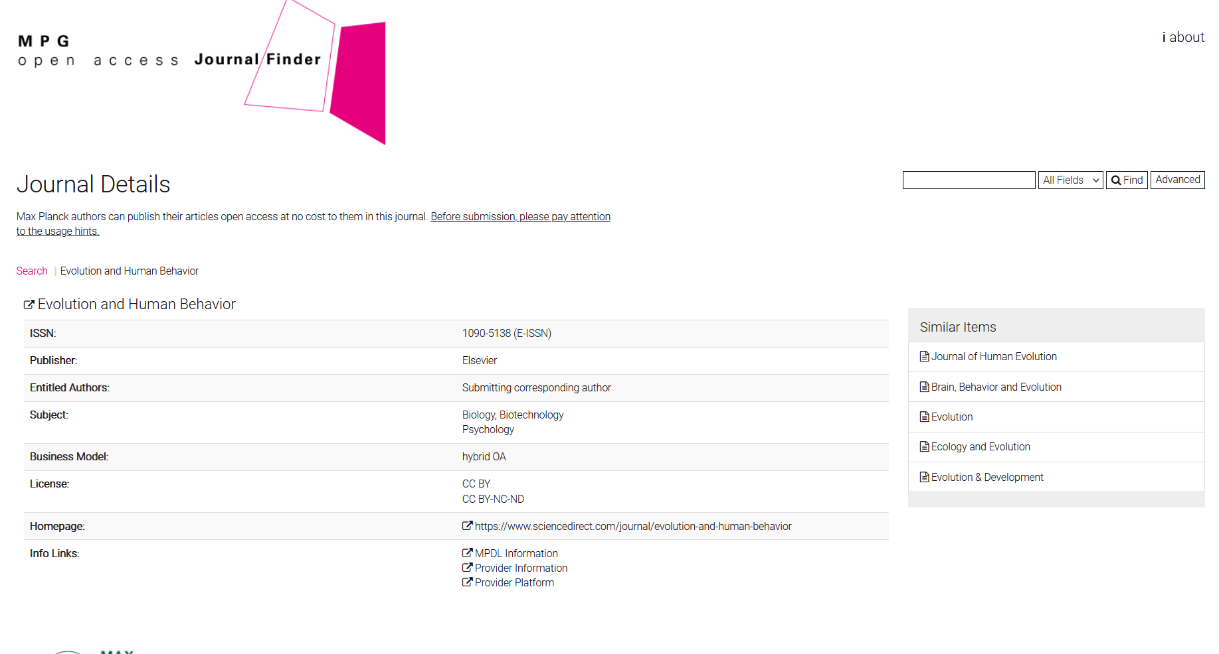
Mpi general staff meeting december 17, 2024

Slide 43
Mpi general staff meeting december 17, 2024
Check before submitting: the
submitting corresponding author must have an MPI / MPG affiliation
Notes:
Used to be a formality but seems to be really critical now.

Slide 44
Mpi general staff meeting december 17, 2024
Overview Publications 2024
Top 12 journal | publications
Scientific Reports | 9
Journal of Cognitive Neuroscience | 7
PNAS | 6
Brain Structure & Function | 5
Frontiers in Psychology | 5
Nature Communications | 5
Behavior Research Methods | 4
Cognition | 4
Language, Cognition& Neuroscience | 4
Neurobiology of Language | 4
PLOS ONE | 4
Quarterly Journal of Exp Psychology | 4
Total 239 publications
Notes:
185 journal articles in total, 49 open access. OA is 29% that is declining, reasons: collaboration, stricter regime publishers and DEAL , 185 journal articles in 109 diff. Journals, top 12 journals make 1/3 61 publications, 23 journals have 2 or 3 publications and 71 titles with one.

Slide 45
Mpi general staff meeting december 17, 2024
Open Access = CC BY
https://deal-konsortium.de/en/why-ccby

Slide 46
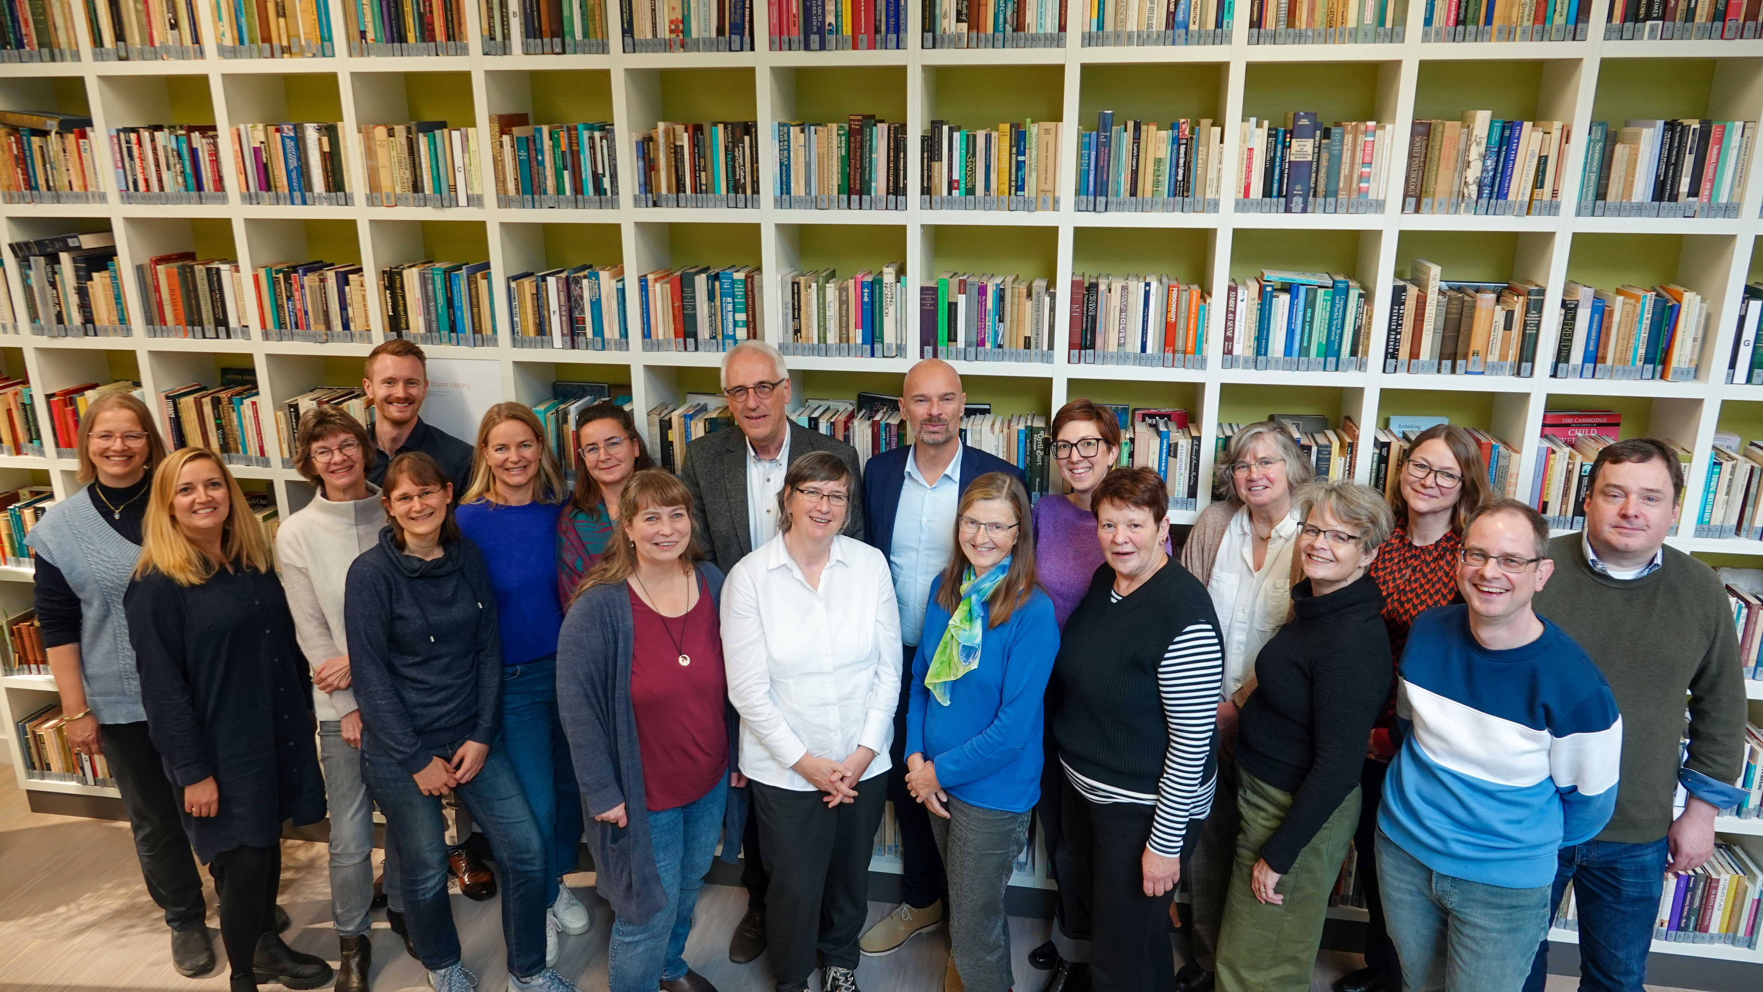
Mp general staff meeting december 17, 2024
Humanities and Social Sciences Librarians
Notes:
We had a wonderfull meeting in our institute, they like the atmosphere and were also very interested in our research. They discussed new search systems, listened to talks on Open Science and research data management, and exchanged practical information for their work. They also got to know our institute through an introduction by Simon Fisher and tours of the BabyLab, Motion Capture Lab and Weblab. They were very impressed by our research and the friendly atmosphere in the Institute.

Slide 47
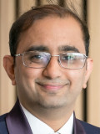
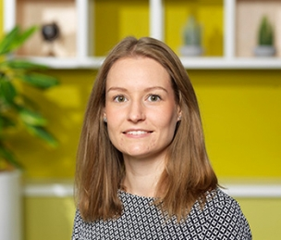
Mpi general staff meeting december 17, 2024
Library Committee Members
http://maxintra.mpi.nl/representation/Library%20committee
Andrea Martin (chair)
Language and Computation in Neural Systems
Sanjeevan Jahagirdar
Language and Genetics Department
Eleanor Huizeling
Multimodal Language Department
Chih Yeh
Language Development Department
Library staff
Karin Kastens; head of library
Meggie Uijen; assistant librarian
email: library@mpi.nl

Slide 48
Mpi general staff meeting december 17, 2024
Open Science Ambassadors
Julia Chauvet
Psychology of Language Department
Ingrid Szilagyi
Language and Genetics Department
Kyla McConell
Psychology of Language Department
The MPI Open Science Ambassadors promote transparency, reproducibility and collaboration in scientific pursuits at our Institute.
As part of the wider MPG Open Science Ambassadors program (https://osip.mpdl.mpg.de/), we focus on making research articles, data, code, peer review, and educational materials open and reproducible and making science transparent and accessible to citizens of our communities.
At the MPI, we are involved in planning workshops related to Open Science, FAIR principles, supporting and guiding our colleagues in embracing Open Science principles, and inspiring interest in open practices.

Slide 49
Mpi general staff meeting december 17, 2024
Open Science Ambassadors
on MAXINTRA
Want to sign up?
e-mail Ingrid.Szilagyi@mpi.nl
MPI Archive hands-on workshop
Tuesday 23rd, January at 09:00 – 12:00
Hands-on workshop to upload data to the MPI Archive
Recently completed/ongoing projects
Receive preparation guidelines ahead of the workshop
Receive technical help during the workshop

Slide 50
Diversity, Equity, and Inclusion
dei@mpi.nl

Slide 51
Mpi general staff meeting december 17, 2024
Who we are
Committee Chair (Candice Frances)
Chair for Attracting Diversity (Izabela Jordanoska)
Chair for Diversity and Inclusion (Sandra Bethke)
Chair for Diversity in our Science (Barbara Molz)
Members from all levels, departments, and groups at the MPI
Notes:
Attracting Diversity to MPI-PL. Here we focus on how to attract employees (both scientific and support staff) from a wider range of backgrounds, both to MPI-PL and into language sciences in general. Examples of initiatives might include the IMPRS’s Talent scheme, reviewing and revising appointment procedures, producing guidelines and training for research leads on how to run inclusive appointment procedures, working with RU to provide more support for dual-careers, coordinating institute involvement in outreach events, and developing strategies to appoint more diverse people at leadership level.
• Diversity and Inclusion at MPI-PL. Here we focus on improving the work environment for current MPI employees in order to promote inclusion and ensure that the diverse groups we recruit are well and equably supported. Activities here might include making sure that all MPI documents, and our website and intranet, use inclusive language, creating communication routes so that employees can easily find information on diversity and inclusion, training supervisors and research leaders in how to lead diverse teams effectively, creating induction and support schemes explicitly designed to support international staff/students (e.g. buddy schemes), and setting up regular workshops to discuss diversity and inclusion (e.g. in collaboration with Radboud University)
• Diversity in our Science. Here the focus is on our scientific activities, in recognition that most research in the field of language sciences reflects a very narrow demographic, which misrepresents how most of the world use language. This area also focusses on how to make our research activities (e.g. conferences) more accessible and inclusive. Examples of activities here might include producing guides for diverse and inclusive science and for running accessible events, producing system for rewarding/promoting diverse science (e.g. dedicated slot at Proudly Presents), increasing exchanges/collaborations with universities in under-represented countries, and lobbying funders and scientific organisations to prioritise diverse and inclusive science.

Slide 52
Mpi general staff meeting december 17, 2024
Talent+ Program: 3 Months
Anjoom Thahir
Alikkam Veetil
ImaGe
Meng-Yun Wang and Jitse Amelink
Carolina Rodríguez Chavarría
LaDD
Yayun Zhang
Kaan Bayar
LaCNS
Anna Mai and
Filiz Tezcan

Slide 53
Mpi general staff meeting december 17, 2024
Talent+ Program: 6 Months
Deema Takaleh
L&G
Else Eising and Barbara Molz
Divyanshu Pathak
LEADS
Limor Raviv
Monserrat Soberanes
CoBra
Linda Drijvers

Slide 54
Mpi general staff meeting december 17, 2024
Talent+ Program: Where are we from?

Slide 55
Mpi general staff meeting december 17, 2024
Talent+ trainings
Workshops
CV/Cover letter
Presentation Skills
Intro to Open Science
Academic Writing
Intro to Neuroimaging
Statistics
Research Methods
Progamming Basics
Dutch Language and Culture
Lab Tours
VR + Motion Capture (MPI)
Babylab (MPI)
Wetlab (MPI)
Eye-Tracking (MPI)
DCC
BSI
CLS
DCCN

Slide 56
Mpi general staff meeting december 17, 2024
Talent+ People
Core Team
Candice Frances
Kevin Lam
Izabela Jordanoska
Caroline Rowland
Teaching
Ellen Verhoef
Figen Karaca
Orhun Uluşahin
Jenni Sander
Mark Dingemanse
Dong Tianai
Loïs Dona
Lanmiao Liu
Susanne Brouwer
Anne Buizer
Iris Schmits
Yayun Zhang
Dilys Eikelboom
Noemi Mena Montes
Lab tours
Paul van der Laan
Sachit Misra
Jean Corbally
Danielle Houwing
Jasper Bok
Ellie Huizeling
Morgane Pierolo
Marieke van der Akker
Ciske Jansen
Anna Aumeistere (BSI)
Jiska Koemans (DCC)
Erik van den Berge (DCC)
Kevin Liu (DCC)
Chengjia Ye (DCC)
Stephanie Forkel (DCCN)
Leila Mossaouir (DCCN)
Claire Pleche (DCCN)
Paul Gaalman (DCCN)
Kenneth van der Zee (DCCN)
Margret van Beuningen (CLS)
Welcome team
YaSuei Cheng
Paula Rubio Fernandez
Assistants
Naomi Smolenaers
Anne Buizer
Secretaries
Paulina Grzenia
Martina Bernhard
Brigit van Loon
Ilse van den Dobbelsteen
Thy Mathu
Benedicte Mbala-Nguyen
Operations
Angela Heuts
Arnold Harbers
Cedric Gertzen
Supervisors
Yayun Zhang (LaDD)
Meng-Yun Wang (ImaGe)
Jitse Amelink (ImaGe)
Anna Mai (LaCNS)
Filiz Tezcan (LaCNS)
Barbara Molz (L&G)
Else Eising (L&G)
Linda Drijvers (CoBra)
Limor Raviv (LEADS)

Slide 57
Mpi general staff meeting december 17, 2024
MPI-Wide Workshop: Unconscious bias training
October 1st
Examine the unconscious biases you have and experience, and learn from two experts of Radboud's In’to Languages team how to become aware of your own biases and gain strategies to help you tackle them.
26 attendees of all departments

Slide 58
Mpi general staff meeting december 17, 2024
Wellbeing Event
November 5th
Workshops, classes, talks, and snacks related to wellbeing
44 participants of all departments
Coming back in 2025!
Early next year we’ll send the save the date
Call for organizers!
Help us organize the next wellbeing event!
Email dei@mpi.nl or Candice.frances@mpi.nl

Slide 59
Mpi general staff meeting december 17, 2024
Social activities
VrijMPIbo:
aka Friday PubNight aka Friday Drinks aka Friday Snacks
Next in Jan or Feb
Networking Gamenight
In October, 13 people; in November 10 people
Location: MPI common area next to the library
Will come back in the new year
→ stay tuned to the Newsletter

Slide 60
Mpi general staff meeting december 17, 2024
Buddy system
Restarted the pilot program
Now in theory open for every new member
Procedure integrated to the ‘essential starting guide’
Info sheet and newcomer form will be shared latest on the first day at the MPI
Pairing done by the buddy TEAM
Call for new buddies!
For the buddy system to be sustainable, we need more volunteers (all MPI staff, min 1 year)
Time commitment :
2-3 in person meetings, available for questions via email
If would like more info
buddy@mpi.nl

Slide 61
Mpi general staff meeting december 17, 2024
Employee and Manager Assistance Program (EMAP)
Financed by the Max Planck Society
Virtual, short term appointments (by phone, online, or in person)
For all kinds of work and non-work issues
Unlimited sessions (meant for crisis management)
Multilingual counseling
Counseling for all staff members and their family
No need for identification, just say you’re an MPI employee
If you’re not sure whether this applies to you please, come ask me
https://maxintra.mpi.nl/services/human-resources/occupational-health-management
https://max.mpg.de/Service/Beratungsangebote/Pages/EMAP_EN.aspx

Slide 62
Mpi general staff meeting december 17, 2024
How to get involved in the DEI movement
Join the Committee (meetings once per month)
Email dei@mpi.nl
(note these emails are received by all committee members)
Email candice.frances@mpi.nl (chair)
Email ideas and suggestions to the committee
Do/support diverse and inclusive science!
Collection of articles from Nature Human Behavior: https://www.nature.com/collections/daficfhiff

Slide 63
Research Staff Committee
Yayun Zhang

Slide 64
MPI GENERAL STAFF MEETING DECEMBER 17, 2024
Purpose of the Committee
Forge connections between research staff members across departments (e.g., organizing social events or workshops).
Provide support for research staff members with issues that are broader than those that can be addressed within their department (e.g., administration issues, training opportunities, or career planning).
External staff representative represents the scientific staff of our institute at MPG-wide meetings

Slide 65
MPI GENERAL STAFF MEETING DECEMBER 17, 2024
Research Staff Committee Representatives
Yayun Zhang (Chair)
Research Staff Rep.
LaDD
Danielle Houwing
Research Staff Rep.
L&G
Nienke Rulkens-Dijkstra
Research Support Staff Rep.
LaDD
Sharice Clough
Research Staff Rep.
MLD
Kyla McConnell
Research Staff Rep.
PoL

Slide 66
MPI GENERAL STAFF MEETING DECEMBER 17, 2024
External Representatives
External Staff Representative
Anna Mai
External Staff Rep.

Slide 67
MPI GENERAL STAFF MEETING DECEMBER 17, 2024
External Representatives
External Staff Representative
PostdocNet External Representative
Anna Mai
External Staff Rep.
Sergio Miguel Pereira Soares
PostdocNet External Rep.

Slide 68
MPI GENERAL STAFF MEETING DECEMBER 17, 2024
Postdoc council representatives
MPI is a full member of Donders Institute
Each Donders center has postdoc representatives who aim to assist with the postdoc life at the Donders Institute:
DCC: Dominika Radziun, Tilman Stephani
DCCN: Anouk van der Heide (chair), Nico Adelhöfer, Yamil Vidal
DCMN: Barbora Rehak-Buckova, Charlotte Fraza, Mireia Coll-Tané
DCN: Abdelrahman Rayan
MPI: Danielle Houwing
Danielle Houwing
Research Staff Rep.
L&G
Notes:
The postdoctoral representatives are members of the postdoctoral community. They form the postdoc council and organize events and activities for postdocs Donders-wide. You can contact them here if you have any questions about past/future postdoc events.

Slide 69
MPI GENERAL STAFF MEETING DECEMBER 17, 2024
Postdoc council member wanted!
The postdoc council of the Donders institute is looking for a second postdoc council member representing the MPI. The postdoc council organizes (social) events and activities for postdocs Donders-wide (Postdoc Ponders).
They meet monthly to plan upcoming events and to discuss ongoing postdoc related matters. Interested? Send an email to: RSC@mpi.nl

Slide 70
MPI GENERAL STAFF MEETING DECEMBER 17, 2024

Slide 71
MPI GENERAL STAFF MEETING DECEMBER 17, 2024
Contact information
To all staff: Don’t hesitate to contact any of us if you have issues or questions!
RSC@mpi.nl

Slide 72
Gender Equality Officers
Staff meeting 17 December 2024
Gender equality officers

Slide 73
Mpi general staff meeting december 17, 2024
Gender Equality Officer (GEO’s)
What do we do?
Point of contact for employees for concerns/issues about inequality, discrimination, harassment
Structural involvement
Increase visibility of Gender Equality Work and Support channels.
Work closely together with the Diversity Equity & Inclusion Committee
Regular meetings with MD, HR, COO, & the other support channels
Formulate Gender Equality Plan
Notes:
In this picture you also see the GEOs. We are female employees and we are elected by female employees, compliant to MPG regulations, but we support all genders. It is important to also notice that we are independent in this role.
Our role is twofold. We are the point of contact for all employees for concerns or issues about inequality, discrimination, harassment, or any other issue which is troubling someone. We advise about further actions, entirely confidential.

Slide 74
Mpi general staff meeting december 17, 2024
Gender Equality Plan 2024 -2026
Report of Commission »Quality Management of Max Planck Gender Equality Plans (GEP):
The Max Planck Institute for Psycholinguistics has submitted a Gender Equality Plan (GEP) that meets the Max Planck standards – comprehensiveness, institutional fit and sustainability – to an outstanding degree.
The Max Planck Institute for Psycholinguistics presents an excellent gender equality strategy, which, among other things, impresses with an extraordinarily comprehensive inventory and an ambitious portfolio of measures.
Link to GEP: https://maxintra.mpi.nl/sites/default/files/2024-07/GEP-2024-2026-MPIPL.Maxintra.EN-compressed.pdf

Slide 75
Mpi general staff meeting december 17, 2024
Update on current projects
COLLABORATION OF SUPPORT CHANNELS
We set up regular meetings with all support channels to facilitate support and communication:
Current status: Get an overview of current support cannels at the MPI, how they currently provide support, what specific topics they cover and for whom.
Our overall aim is to implement a best-practice guide. As an example, the different channels can collaborate and discuss possibilities for how part-time solutions for scientific staff could be realized.
INVOLVEMENT OF GENDER EQUALITY OFFICERS IN HIRING PROCEDURES
By being more structurally involved, we aim for more equal and equitable hiring procedures across the Institute, as well as encouraging the hiring of under-represented groups.
Current status: started to be part of hiring procedures for jobs of institute-wide relevance
Our overall aim is to provide a best-practice guide for hiring procedures

Slide 76
Mpi general staff meeting december 17, 2024
Election of the Gender Equality Officers
Karin Kastens
Gender Equality Officer
Barbara Molz
Deputy Gender Equality Officer
Annelies van Wijngaarden
Deputy Gender Equality Officer
A big thank you to everyone who participated in the November 2024 Election for Gender Equality Officers. We are really happy and appreciate your trust and will work together for getting our projects going and most importantly support all of you whenever you need support.

Slide 77
Mpi general staff meeting december 17, 2024
EMAP - Employee and Manager Assistance Program
https://maxintra.mpi.nl/our-mpi/emergency-information/247-free-mental-health-support
Registration and Sign Up:
0800 / 0229543

Slide 78
MPI General staff meeting december 17, 2024

Slide 79
Mpi general staff meeting december 17, 2024
Contact Information
Gender Equality Officer: Karin Kastens
Deputy Gender Equality Officer: Barbara Molz
Deputy Gender Equality Officer: Annelies van Wijngaarden
Email: equality@mpi.nl
Equal Opportunities on MaxIntra
https://maxintra.mpi.nl/our-mpi/support-representation/equal-opportunities
Equal Opportunities on www.mpi.nl
https://www.mpi.nl/page/equal-opportunities
Max Planck Society on Equal Opportunties
https://www.mpg.de/equal_opportunities

Slide 80
Sustainability Working Group
Staff meeting December 17, 2024
Clara kunst

Slide 81
Sustainability Working group – MPI GENERAL STAFF MEETING DECEMBER 17, 2024
Our Group
Caitlin Decuyper
Kevin Lam
Clara Kunst
sustainability@mpi.nl
Sandra Bethke
Jurgen Heijsen
Fatma Uzbas
Orhun Ulusahin
Dilys Eikelboom

Slide 82
Sustainability Working group – MPI GENERAL STAFF MEETING DECEMBER 17, 2024
What’s been happening?
We organized a workshop in collaboration with the RU Green Office
Output of the workshop was used to identify points of action
We forwarded these points of action to the Directorate and received valuable feedback and/or approval
Constantly working on these points!

Slide 83
Sustainability Working group – MPI GENERAL STAFF MEETING DECEMBER 17, 2024
Past Events
Bike Day
Date: 04 November
Upcoming Events
Wellbeing Event
in collab with DEI Committee
Date: 05 November
Next Movie Night!
Date: early 2025
Other events we’ll co-organize with the DEI committee

Slide 84
Sustainability Working group – MPI GENERAL STAFF MEETING DECEMBER 17, 2024
We are looking for new members!
Want to join us, share ideas, or ask a question?
Contact us at sustainability@mpi.nl

Slide 85
Ombudsperson
Staff meeting December 17, 2024
Beate St Pourcain

Slide 86
Mpi general staff meeting december 17, 2024
End of year speech

Slide 87
Mpi general staff meeting december 17, 2024
MPI End of the Year Party
Scheduled events:
15.30-16:00 hours Get-to-know-people game (Tic tac toe!)
16:00-16:30 hours VR experience 1st timeslot
16:30-17:15 hours MPI Quiz - in 163
17:15-17:45 hours VR experience 2nd timeslot
Ongoing activities in the Common Ground:
Catering incl. hot chocolate and mulled wine (Glühwein)
Bake sale with all proceeds to the Red Cross (pay by cash or scan the QR code)
Spotify playlist with your own music selection

Slide 88
Mpi general staff meeting december 17, 2024
Passions
Tic Tac Toe
Hiking
Annelies
First steps: Each square will hold one "passion" or interest. Each person writes down things they love or are passionate about, one per square. For example: "Cooking," "Hiking," "Gaming," etc.
Group Interaction: Walk around and chat with others.
Filling the Grid: If someone else shares the same passion as you in the same square, they write their name in your matching square and vice versa. Example: Both like "Hiking," so they sign each other's grid. It doesn’t matter which square you start with.
Goal: Try to get three names in a row, column, or diagonal on your tic-tac-toe board. It’s just like winning tic-tac-toe but by connecting shared interests and passions!
Cards and prizes: You can find Yaren at the table under the stairs for the cards, pens and prizes!
Hiking
Yaren

Slide 89
Mpi general staff meeting december 17, 2024
MPI Quiz 2024
Multi-cultural New Years’ Facts and Festivities
Instructions:
Form groups of 5-6 people with participants from:
at least 2 departments/groups
at least 3 countries or cultures (mingle!)
Choose a team name
Sign-up on the sheet
16.30-17.15
in 163
Prizes for the winning team

